Slide 1
How To Make A Bar Graph
Sydney Chase, Ashley Neronha, Jordan Silva, Erika Martin

Slide 2
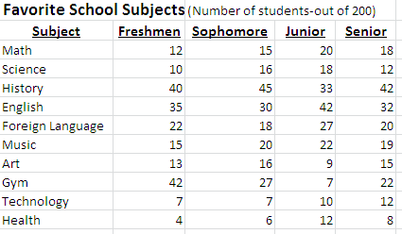
Information in Chart
Type your data/information in a chart in Excel
Next, highlight the chart

Slide 3
Insert
Go to the insert tab
Go under bar and choose which type of chart you want (3-D, 2-D, cylinder)
Select the graph

Slide 4
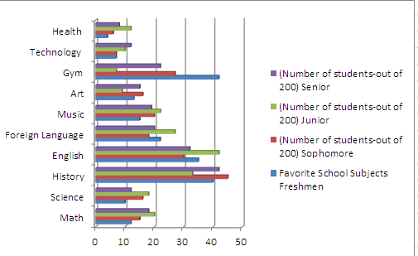
Chart
The area around the chart is called the chart area
The vertical axis is the y-axis, and the horizontal axis is the x-axis
The area bounded by the axes is called the plot area
You can move the chart by clicking inside the chart area

Slide 5
Chart Tools
Three Chart Tool Tabs: Design Layout, Format
You can customize, edit, style, and modify a chart

Slide 6
Why to Use Bar Graph
Display data
Show amounts or the number of times a value occurs
Show and compare numbers
Easy to see the differences in the data being compared

